Slide 1



Investor Behaviour and Market Segmentation Analysis
Presented by Vaibhav Pawar
2024

Slide 2
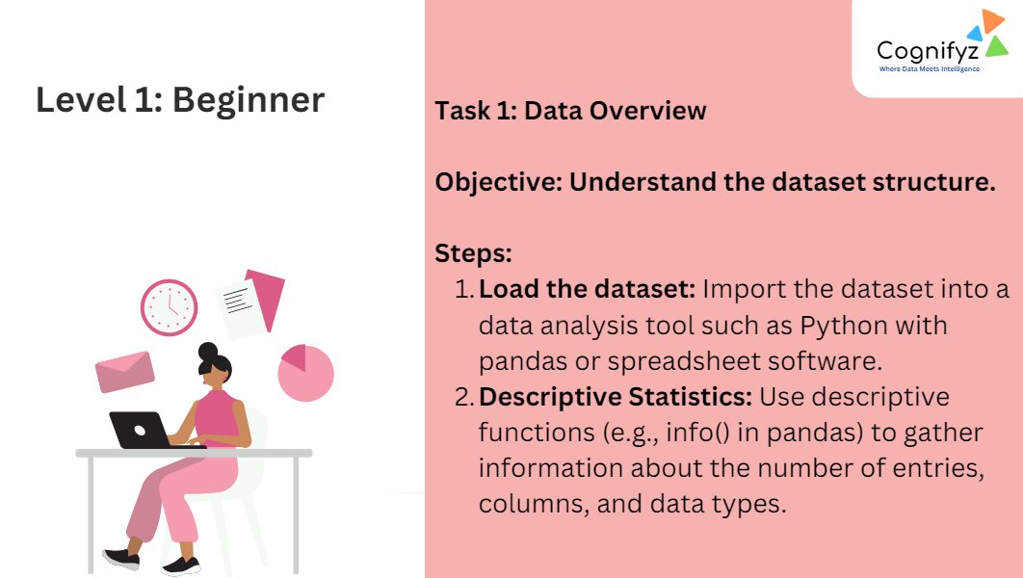
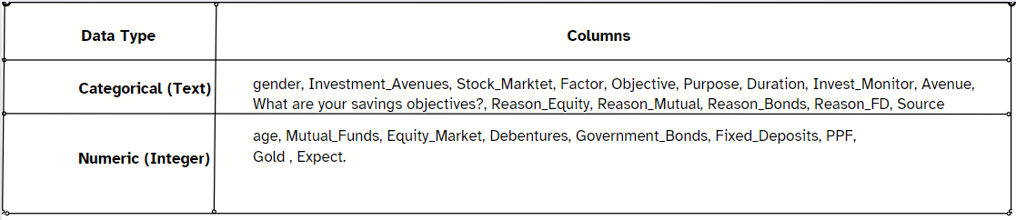
Dataset Summary
Total Entries : 40 rows
Total Columns : 24 columns
Key Statistical Measures for Selected Columns
Age
- Mean : 27.8 years
- Median : 27 years
- Mode : 27 years
- Range : 21 to 35 years
Investment Avenues (Average Investment in Units)
- Mutual Funds : 2.55
- Equity Market : 3.475
- Debentures : 5.75
- Government Bonds : 4.65
- Fixed Deposits : 3.575
- PPF : 2.025
- Gold : 5.975
Insights
- Investors are typically around 28 years old.
- Debentures and gold are the most invested avenues.
- PPF has the lowest average investment.
- Investment patterns show that while some investors prefer larger, more consistent investments in gold and debentures, others have more variability in their investments across mutual funds, equity markets, and fixed deposits.
Dataset

Slide 3
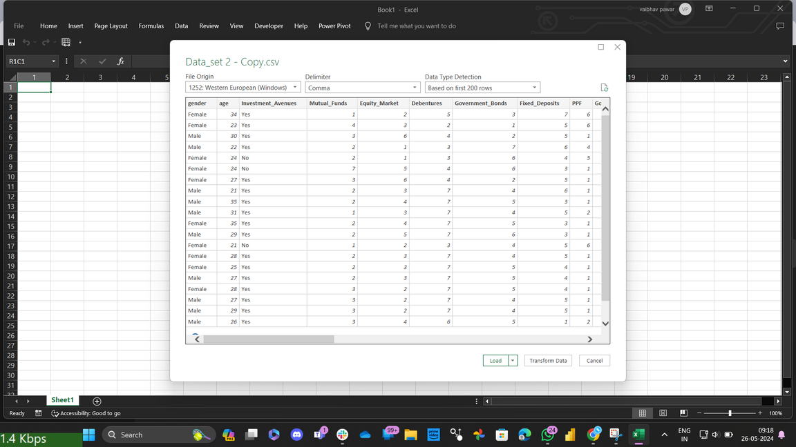
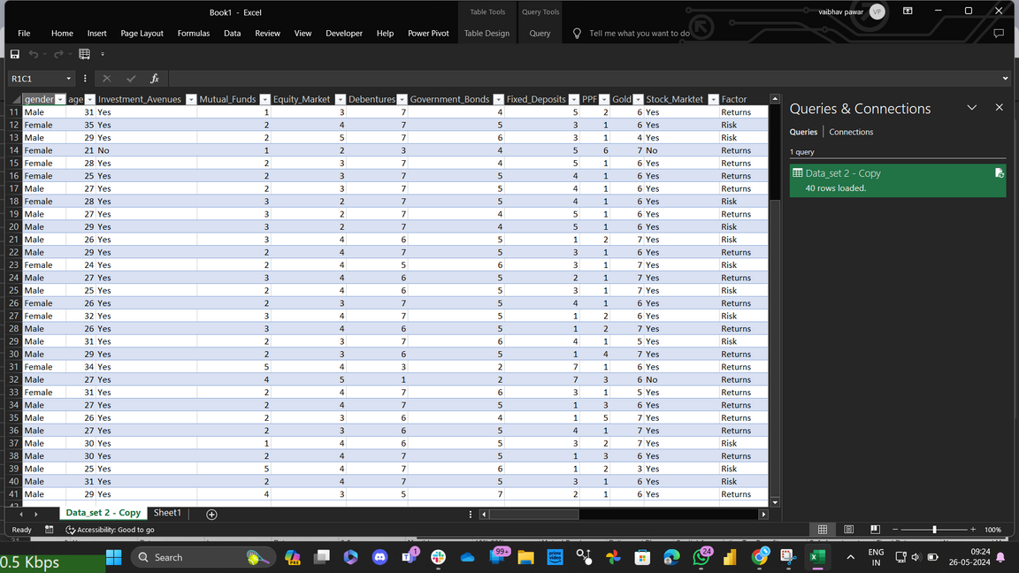
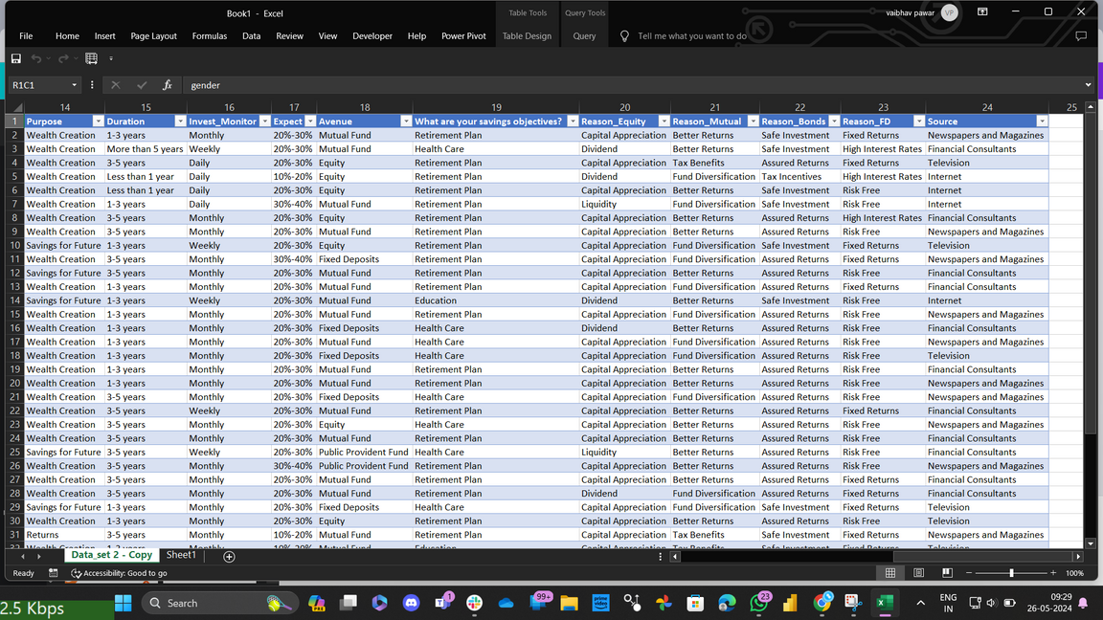
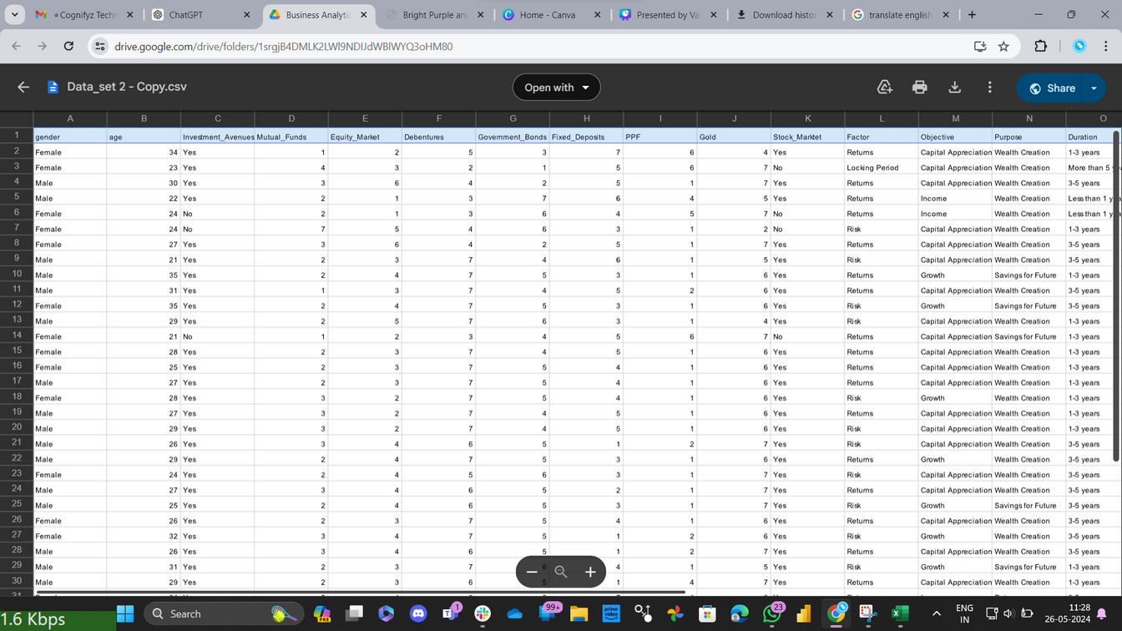

Slide 4
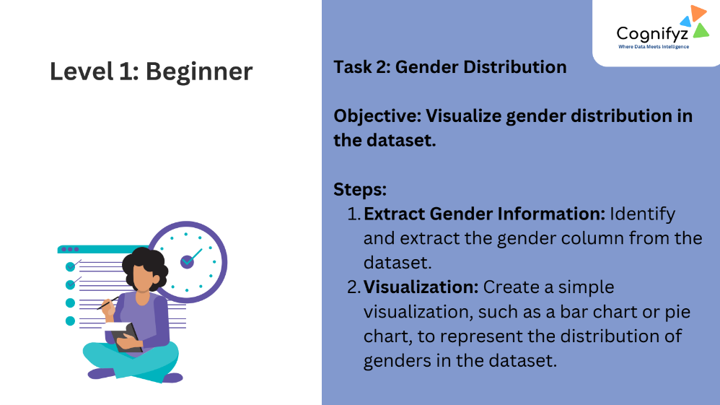
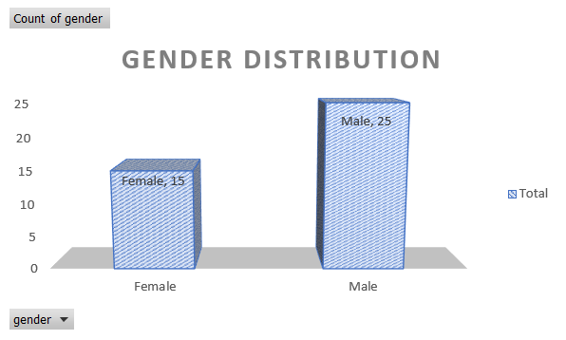
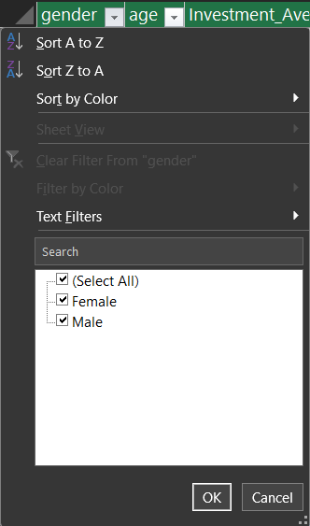
Based on the provided gender data:
Total Entries: 40
Gender Breakdown:
Female: 15 (37.5%)
Male: 25 (62.5%)
Visualization
Bar Chart

Slide 5
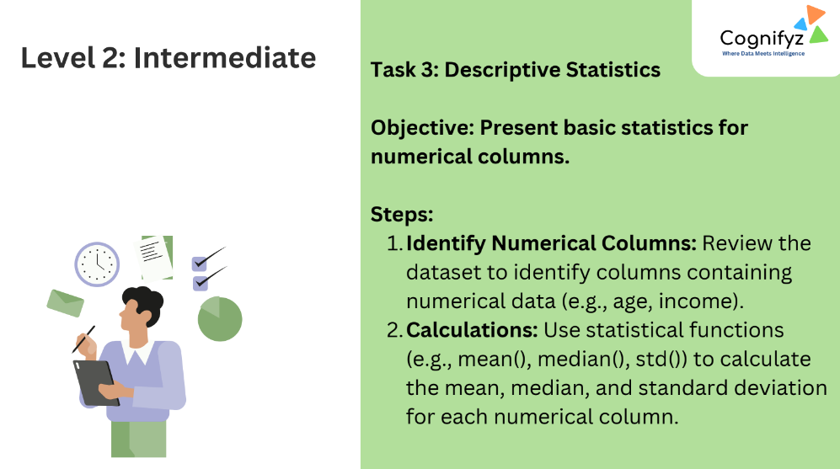

Slide 6
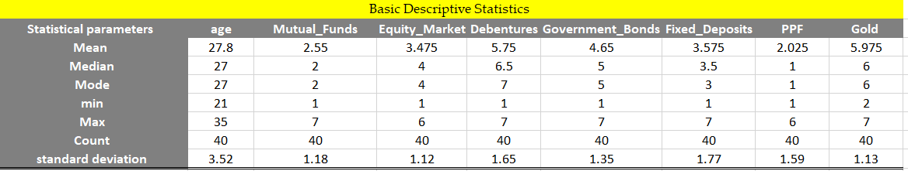
Investment Avenues (Average Investment in Units)
Age
Mean: 27.8
Median: 27
Mode: 27
Range: 21 to 35
Std Deviation: 3.52
Mutual Funds
Mean: 2.55
Median: 2
Mode: 2
Range: 1 to 7
Std Deviation: 1.18
Equity Market
Mean: 3.475
Median: 4
Mode: 4
Range: 1 to 6
Std Deviation: 1.12
Debentures
Mean: 5.75
Median: 6.5
Mode: 7
Range: 1 to 7
Std Deviation: 1.65
Government Bonds
Mean: 4.65
Median: 5
Mode: 5
Range: 1 to 7
Std Deviation: 1.35
Fixed Deposits
Mean: 3.575
Median: 3.5
Mode: 3
Range: 1 to 7
Std Deviation: 1.77
PPF
Mean: 2.025
Median: 1
Mode: 1
Range: 1 to 6
Std Deviation: 1.59
Gold
Mean: 5.975
Median: 6
Mode: 6
Range: 2 to 7
Std Deviation: 1.13

Slide 7
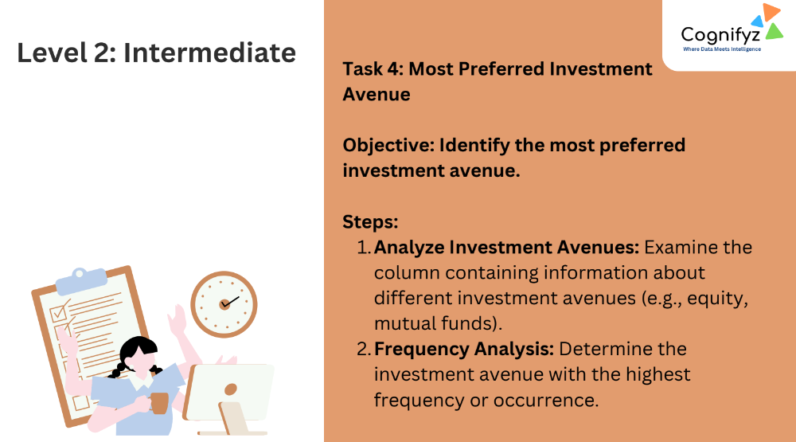
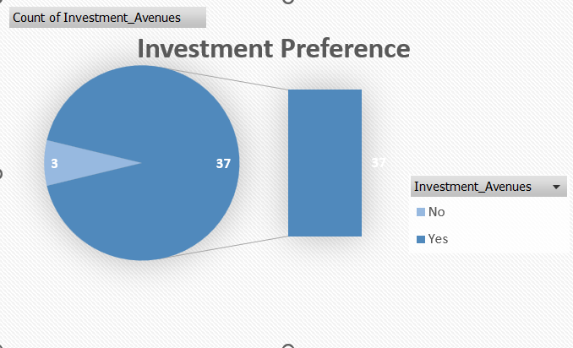
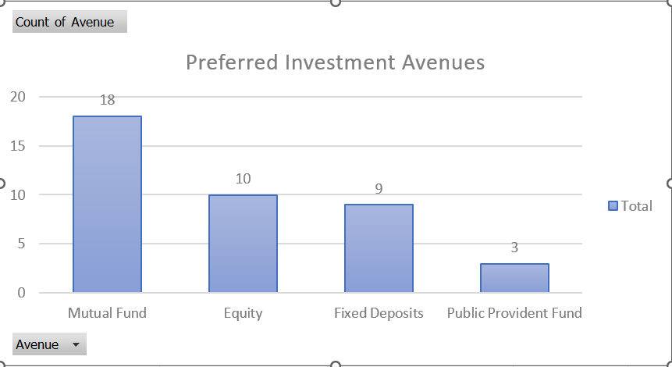
Peapoles preference Summary:
Total YES: 37 Peapole say Yes i.e they preferred to invest.
Total NO: 3 people say No i.e They not to Preferred Investment Avenues.
Investment Preferences Summary:
The table below showing the count of people who prefer each investment avenue:
Mutual Fund: Preferred by 18 individuals.
Equity: Preferred by 10 individuals.
Fixed Deposits: Preferred by 9 individuals.
Public Provident Fund: Preferred by 3 individuals.
Total 40 individuals are there in the dataset.
Peapole most preferred ‘Mutual Fund’ as a investment Avenue.

Slide 8
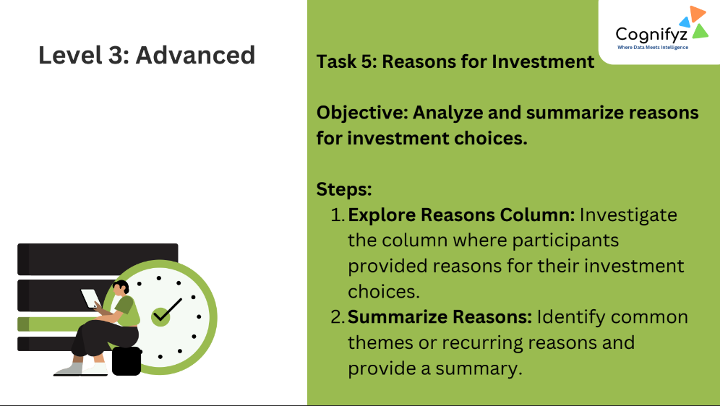
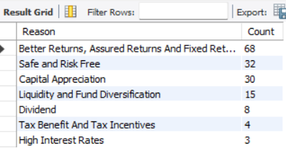
Click Here to see SQl Script
Investment Reasons Summary:
1. Better Returns, Assured Returns, and Fixed Returns
Count: 68
2. Safe and Risk-Free
Count: 32
3. Capital Appreciation
Count: 30
4. Liquidity and Fund Diversification
Count: 15
5. Dividend
Count: 8
6. Tax Benefits and Tax Incentives
Count: 4
7. High Interest Rates
Count: 3
The majority of investors prioritize better returns, safety, and capital appreciation in their investment choices.

Slide 9
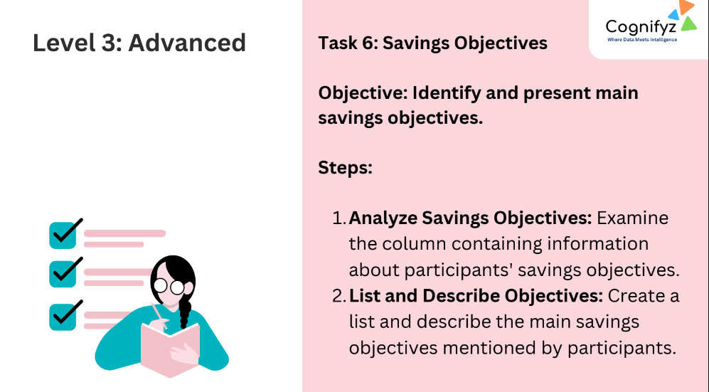
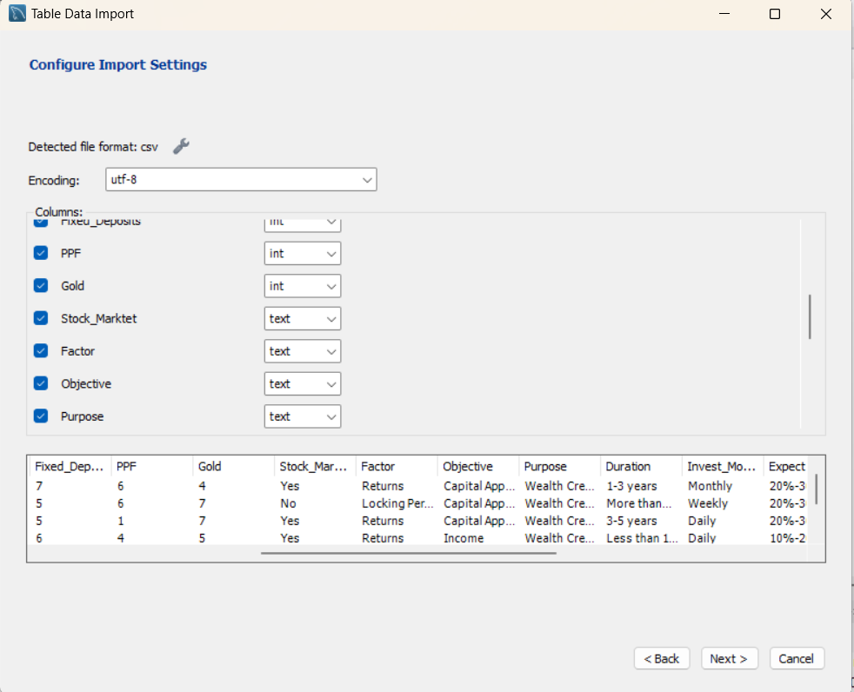
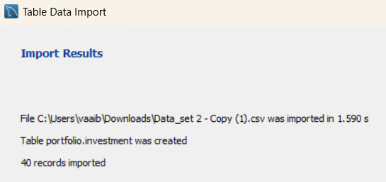

Slide 10
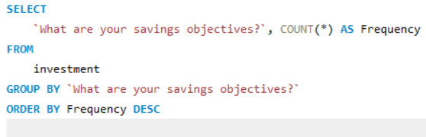
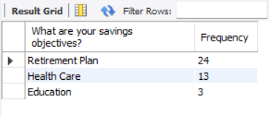
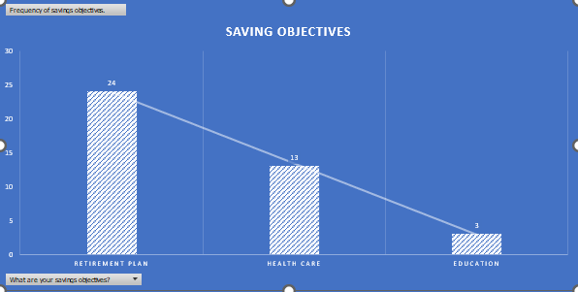
Summary of Savings Objectives:
Based on the frequency analysis of the savings objectives:
1. Retirement Plan
- Frequency: 24 participants
- Description: Most common objective, chosen by 60% of participants, indicating a focus on long-term financial security.
2. Health Care
- Frequency: 13 participants
- Description: Chosen by 32.5% of participants, showing significant concern for medical expenses.
3. Education
- Frequency: 3 participants
- Description: Selected by 7.5% of participants, indicating a minority focus on educational savings.
Insights
- Primary Objective: Retirement planning
- Secondary Objective: Health care savings
- Tertiary Objective: Education savings
Participants prioritize retirement and health care over education for their savings goals.

Slide 11
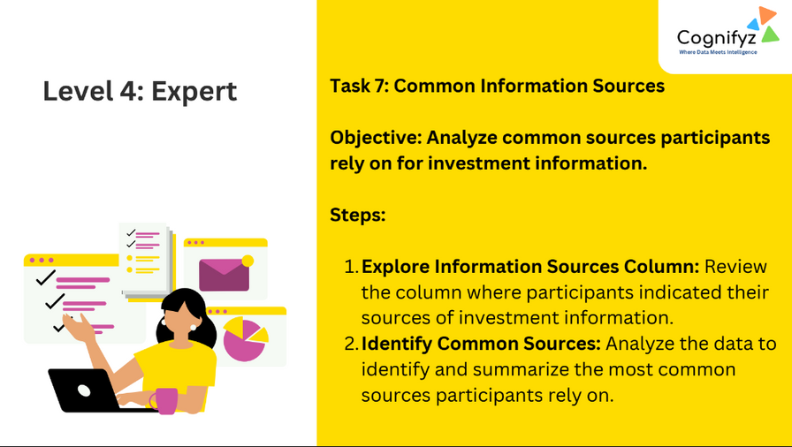
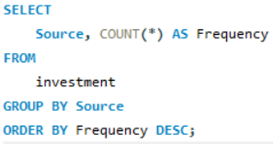
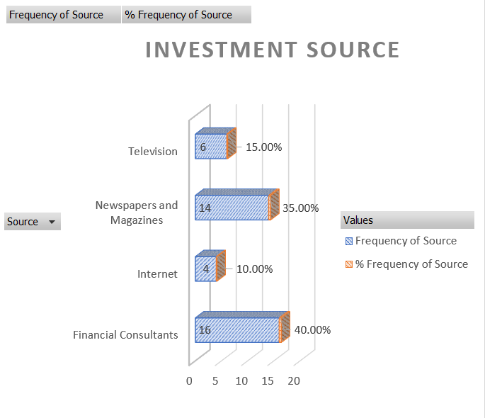
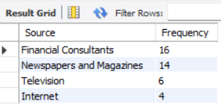
Summary of Common Information Sources
Based on the frequency analysis of the sources of investment information:
Participants mainly rely on financial consultants and print media (newspapers and magazines) for their investment information. Television and the internet are used less frequently. This shows the ongoing importance of professional advice and traditional media sources in making investment decisions in India.
Financial Consultants:
Frequency: 16 participants
Percentage: 40.00%
Newspapers and Magazines:
Frequency: 14 participants
Percentage: 35.00%
Television:
Frequency: 6 participants
Percentage: 15.00%
Internet:
Frequency: 4 participants
Percentage: 10.00%

Slide 12
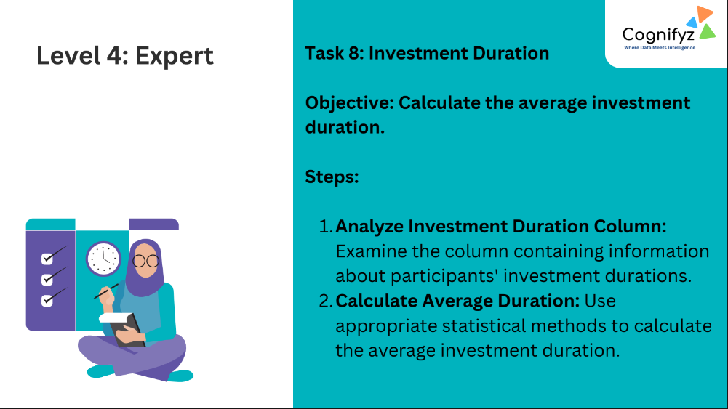
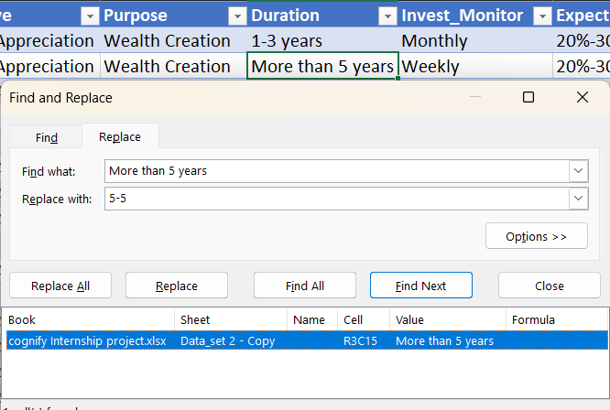
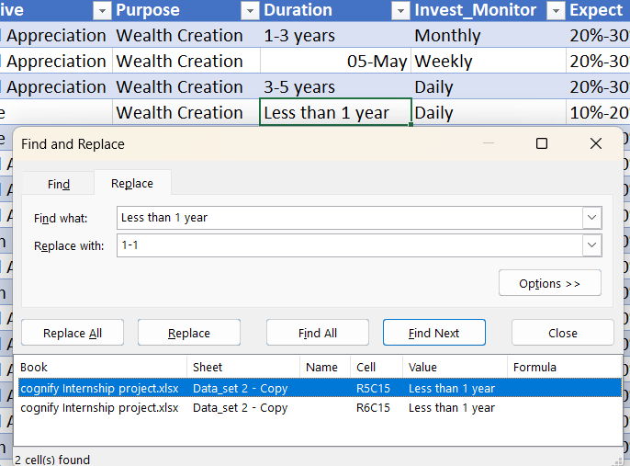
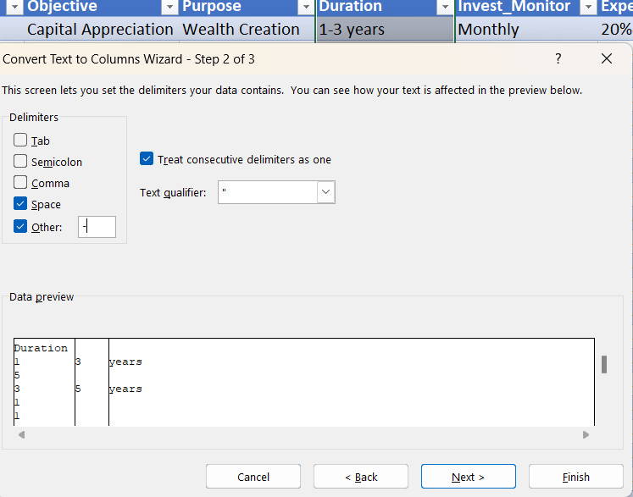
Using Excel:
Splitting the duration column into two different columns naming Duration_start and Duration end.
Splitting can help us to calculate the average investment duration.
We can use the following formula to create another column named ‘Average year‘
Average year =
((Duration_start + Duration_end) / 2)
Then Calculate average of Average year

Slide 13
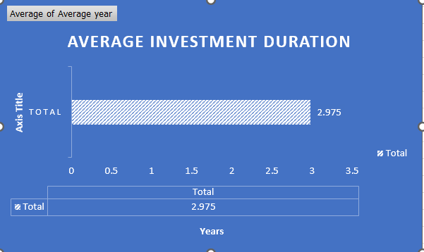

Slide 14
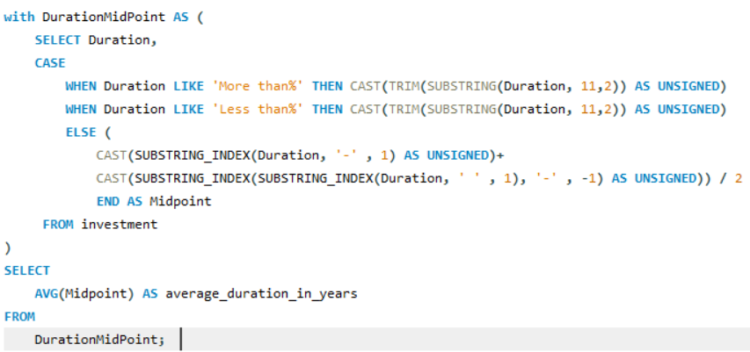
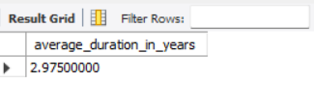
Calculate Average investment duration by using SQL queries.
Explanation of the SQL Query:
WHEN Duration LIKE 'more than%' THEN CAST(TRIM(SUBSTRING(Duration, 11, 2)) AS UNSIGNED):
WHEN Duration LIKE 'less than%' THEN CAST(TRIM(SUBSTRING(Duration, 11, 2)) AS UNSIGNED):
Extracts the substring starting at the 11th character and takes 2 characters (e.g., "5 ").
TRIM is used to remove any leading or trailing spaces to clean up the extracted substring.
CAST(... AS UNSIGNED) converts the trimmed substring to an integer.
CAST(SUBSTRING_INDEX(Duration, '-', 1) AS UNSIGNED)
extracts the value before (‘-‘) of the range.
CAST(SUBSTRING_INDEX
(SUBSTRING_INDEX(Duration, ' ', 1), '-', -1) AS UNSIGNED)
extracts the value before (space) and after (‘-’) of the range.
The midpoint is calculated as the average of These two extracted values.
The outer SELECT statement calculates the average of all midpoints.
Summary of Full Code:
Extract lower and upper bounds from the duration ranges.
Calculate the midpoint for each duration range.
Compute the average of these midpoints to find the average investment duration.
The average investment duration in years = 2.975 years.

Slide 15
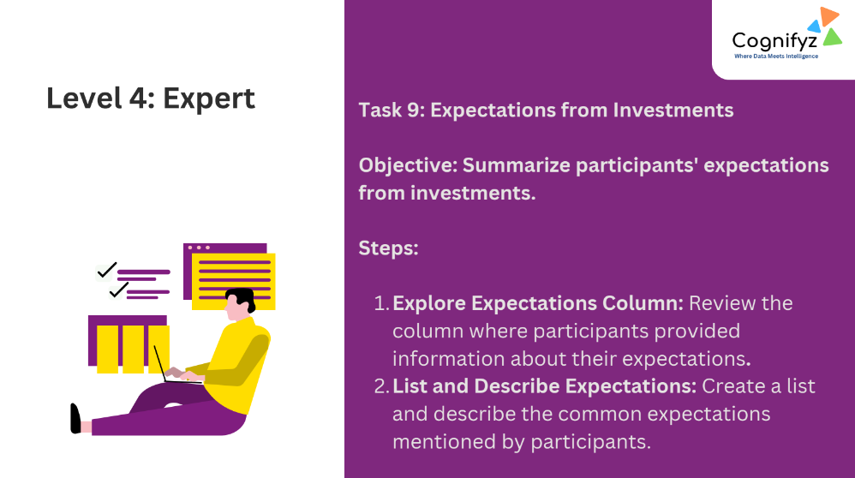
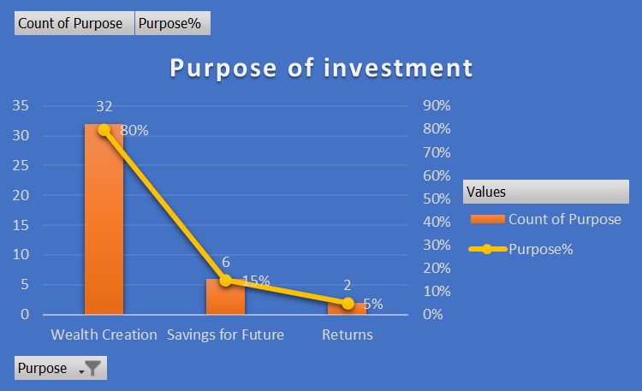
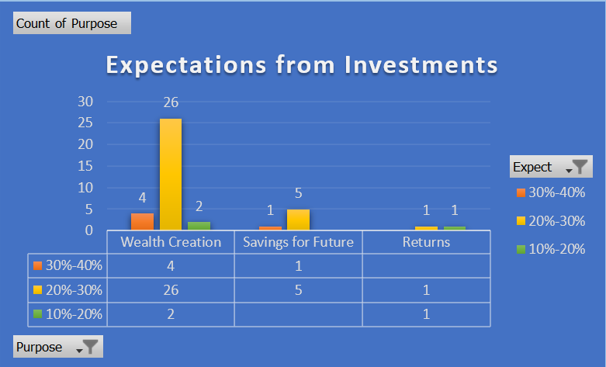
Purpose:
Wealth Creation
Count: 32 investors
Expectations:
26 investors expected
30%-40% returns.
4 investors expected 20%-30% returns.
2 investors.10%-20% returns.
Purpose:
Savings for Future
Count: 6 investors
Expectations:
1 investor expected
30%-40% returns.
5 investors. expected 20%-30% returns.
0 investors. expected 10%-20% returns:
Purpose:
Returns
Count: 2 investors
Expectations:
0 investors expected
30%-40% returns:
1 investor. expected 20%-30% returns.
1 investor expected 10%-20% returns.

Slide 16
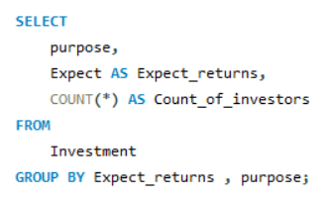
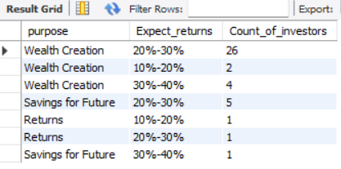
Summarize participants' expectations
from investments, using SQL
Summary:
Wealth Creation:
The majority of participants 32 (80%) are investing to create wealth. Most of these investors expect a return between 20%-30%, with a few expecting higher or lower returns.
Savings for Future:
6 (15%) participants invest with the goal of saving for the future. Most of these investors also expect a return between 20%-30%.
Returns:
A smaller group of 2 participants (5%) is primarily focused on earning returns. Their expectations are split between 20%-30% and 10%-20% returns.

Slide 17
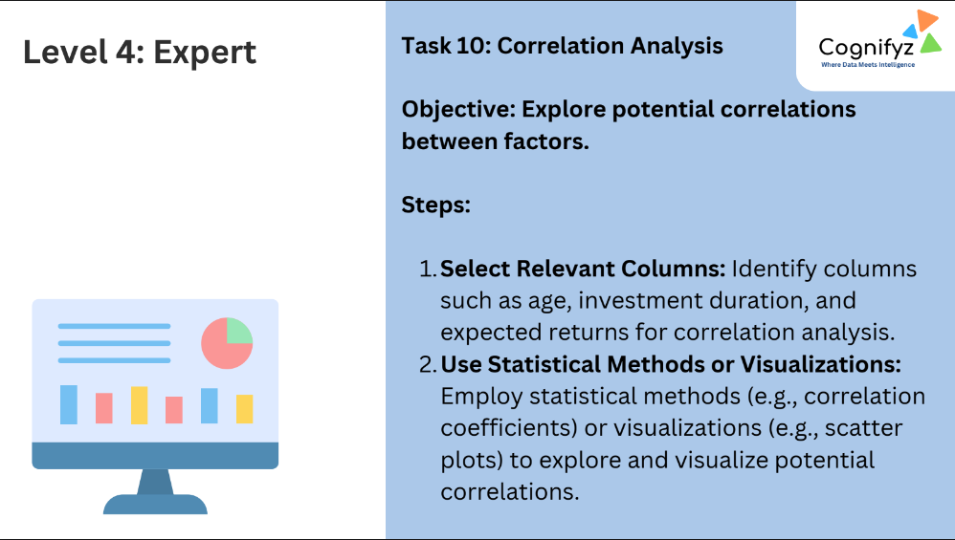
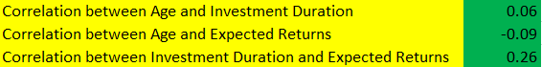
Insights from Correlation Values
1. Age and Investment Duration (0.06):
Almost no relationship. Age doesn't significantly impact investment duration.
2. Age and Expected Returns (-0.09):
Weak inverse relationship. Younger investors slightly expect higher returns.
3. Investment Duration and Expected Returns (0.26) :
Moderate positive relationship. Longer investment durations are associated with higher expected returns.
Summary
Age vs. Duration: Age has minimal effect on investment duration.
Age vs. Returns: Younger participants have slightly higher return expectations.
Duration vs. Returns: Longer investments tend to have higher expected returns.
Used the ‘CORREL’ function in Excel to calculate the correlations between the columns.

Slide 18
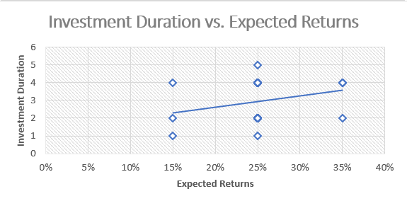
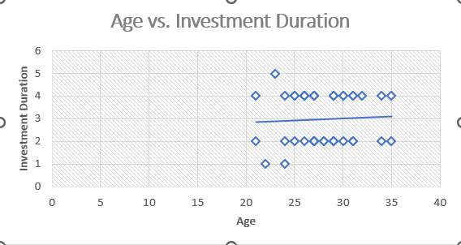
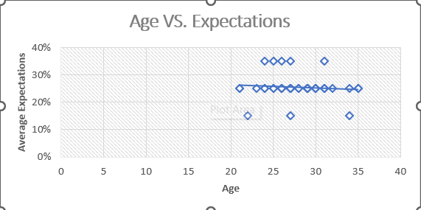
Correlation analysis using ‘EXCEL’
Used the ‘CORREL’ function in Excel to calculate the correlations between the columns.

Slide 19
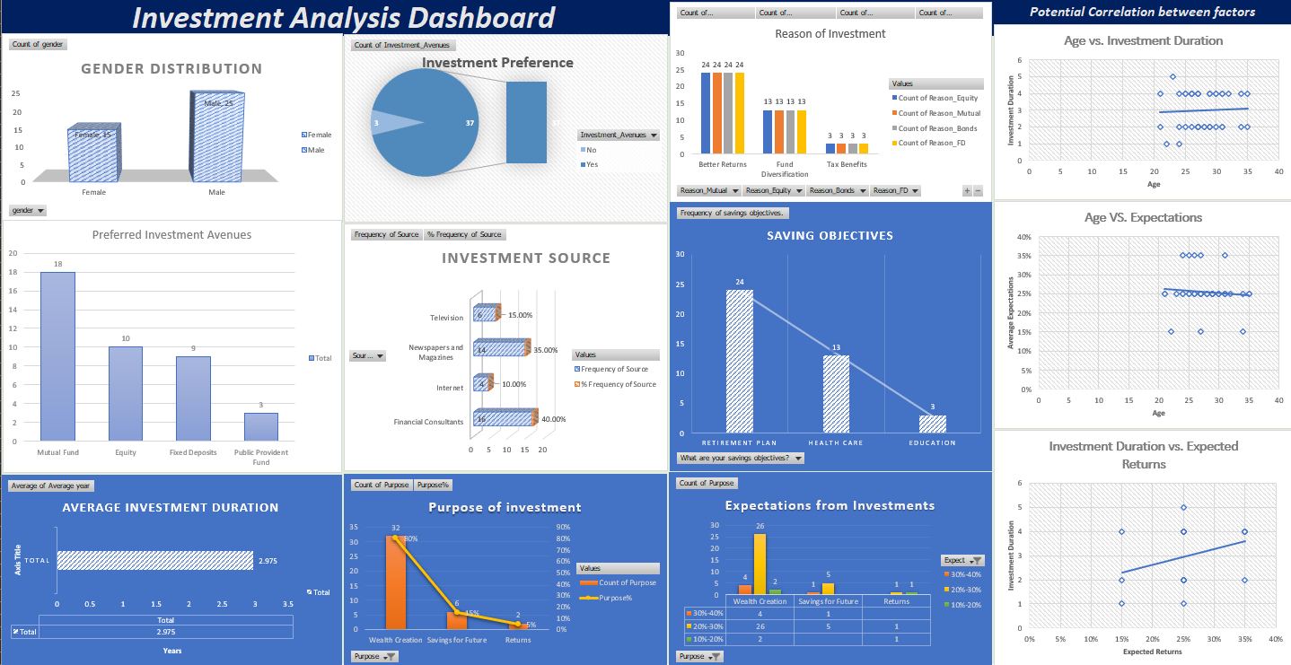
Excel Dashboard

Slide 20


Microsoft Power BI - An Interactive Power Bi Dashboard
Click to open

Slide 21
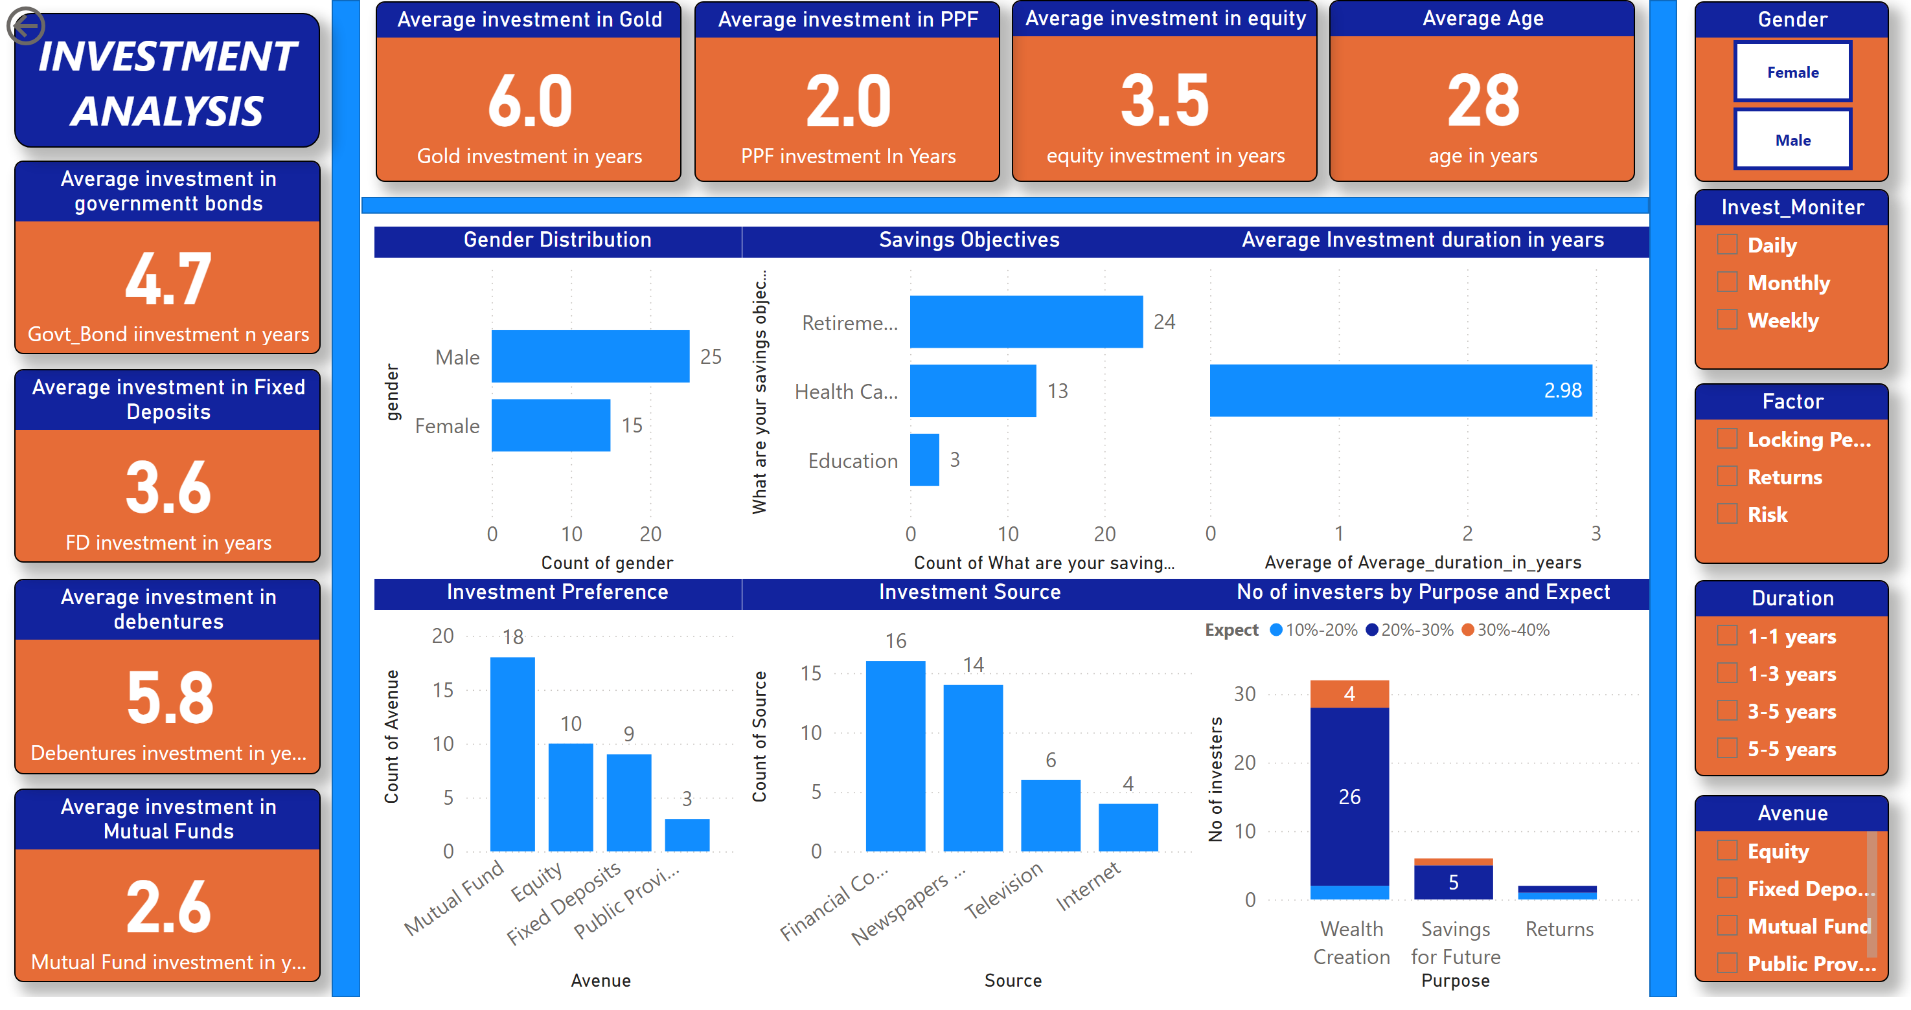
Page 1
Notes:
Gender Distribution
No alt text provided
Average Age
No alt text provided
Average investment in equity
No alt text provided
Average investment in Mutual Funds
No alt text provided
Average investment in debentures
No alt text provided
Average investment in Gold
No alt text provided
Average investment in PPF
No alt text provided
Average investment in Fixed Deposits
No alt text provided
Average investment in governmentt bonds
No alt text provided
shape
No alt text provided
textbox
No alt text provided
shape
No alt text provided
Investment Preference
No alt text provided
actionButton
No alt text provided
Savings Objectives
No alt text provided
Investment Source
No alt text provided
Average Investment duration in years
No alt text provided
columnChart
No alt text provided
shape
No alt text provided
Gender
No alt text provided
Factor
No alt text provided
Avenue
No alt text provided
Invest_Moniter
No alt text provided
Duration
No alt text provided

Slide 22

Thank you
Contact Details
Linkdin
www.linkedin.com/in/vaibhav000
GitHub
https://github.com/Vaibhav3046
Email :
vaaibhav000@gmail.com

